Slide 1

CS 560: Software Engineering
Exercises in Software Engineering II
Dr. Mohammed Ayoub Alaoui Mhamdi
Bishop's University
Sherbrooke, Qc, Canada
malaoui@ubishops.ca

Slide 2
Exercise 1
You are a member of the user interface team. You are responsible for designing and implementing forms collecting information about users of the system (e.g., first name, last name, address, E-mail address, level of expertise). The information you are collecting is stored in the database and used by the reporting subsystem. You are not sure which fields are required information and which are optional. How do you find out?

Slide 3
Exercise 1: Solution
This is an open-ended question whose purpose is to have the student think of all the communication paths available. The side effect of this question is that the student will also have to think about the information sources associated with a project. A correct answer should contain at least two of the following points:
  The user interface team member should first check the requirements analysis document.
  If the answer is not in the requirements analysis document, or if the answer is not clear, the document is incomplete or does not exist yet, in which case the user interface team member should ask the responsible analyst on the project. This is a request for change or a request for clarification.
  If the analyst does not have the answer, he or she should investigate with a potential user and possibly get approval from the client. This is also a request for clarification.
  In all cases, the answer should eventually make its way into the requirements analysis document.

Slide 4
Exercise 2
Which changes in the organization and communication infrastructure would you recommend for a successor of the Ariane 5 project as a consequence of the Ariane 501 failure?

Slide 5
Exercise 2: Solution
This is an open-ended question as many solutions exist and detailed knowledge of the current team organization are not available. Note that this question is only interested in communication or organizational changes, not technical or methodological changes. A correct answer could include the following points:
  Increase communication between the team responsible for system testing and the software developers. This can be done by introducing liaisons on both teams.
  Increase communication between the team responsible for unit testing and for system testing.
  Change documentation requirements for reused components.

Slide 6
Exercise 3
Write the high-level use case ManageAdvertisement initiated by the Advertiser, and write detailed use cases refining this high-level use case. Consider features that enable an advertiser to upload advertisement banners, to associate keywords with each banner, to subscribe to notices about new tournaments in specific leagues or games, and to monitor the charges and payments made on the advertisement account.

Slide 8
Exercise 4
Create a system sequence diagram that describes the main success scenario of the Withdraw money using a Visa card use case from ATM.

Slide 9
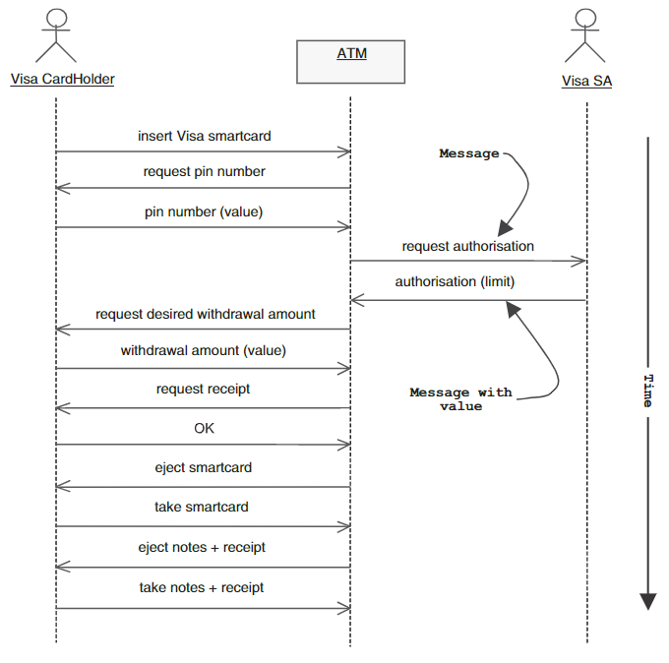

Slide 10
Exercise 5
Expand the system sequence diagram that describes the nominal scenario of the Withdraw money using a visa card use case.

Slide 11
